Slide 1

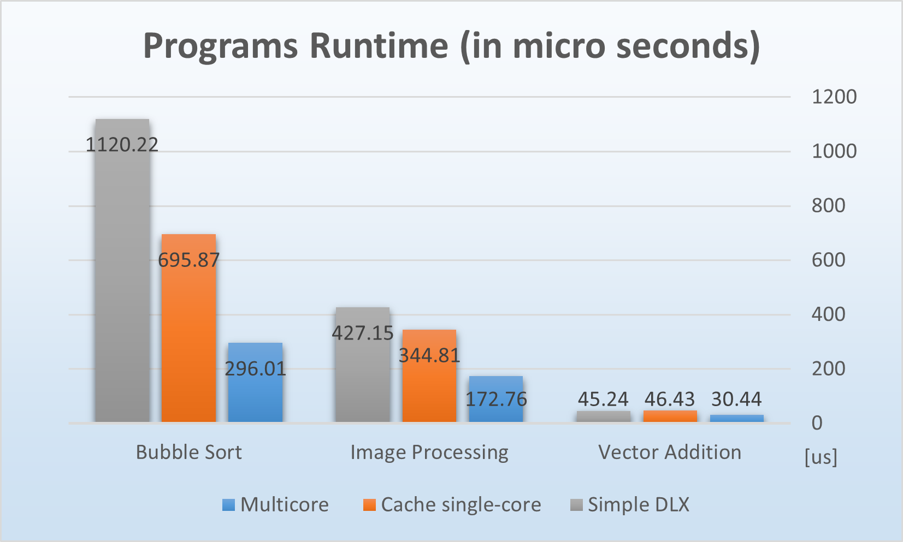
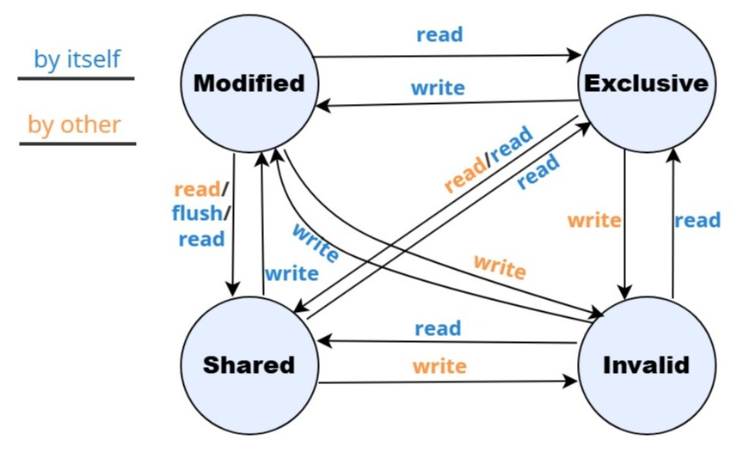
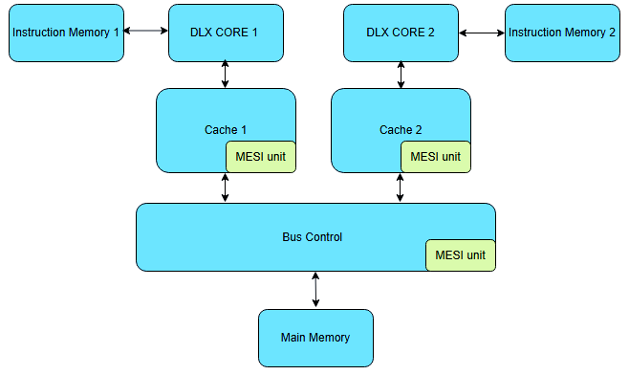
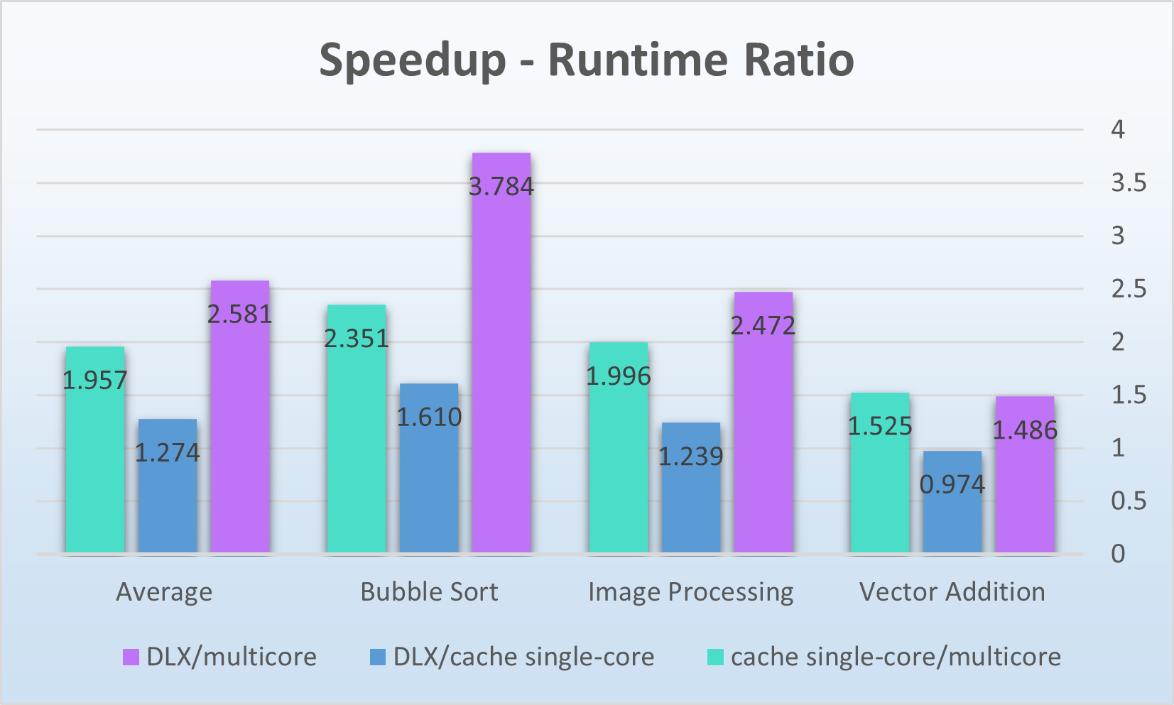
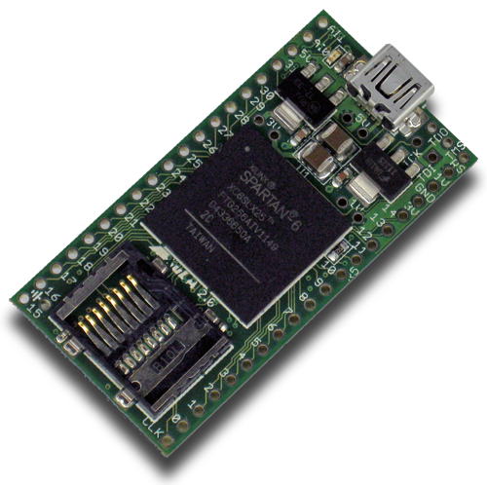
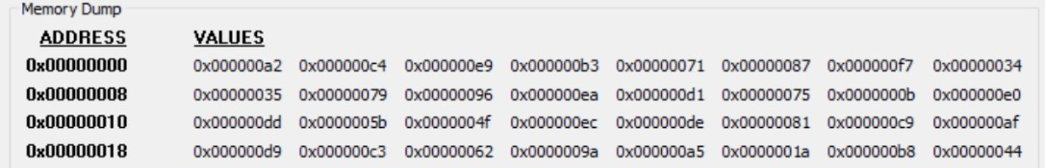
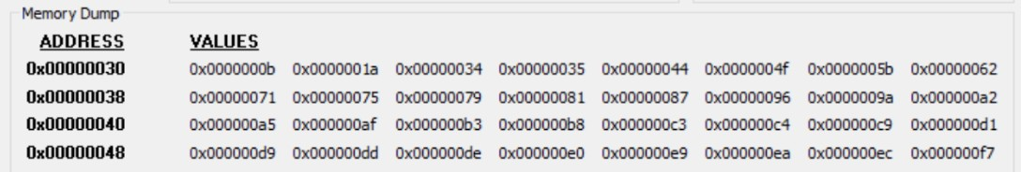
Multicore DLX processor with coherence protocol
Project Number: 24-1-1-3024
Names: Yohai Shiloh and Yarin Koren
Advisor: Oren Ganon
Introduction This project presents an extension to the basic DLX architecture, by using some of the most common methods to improve CPU performance – adding a cache memory for faster memory access and expanding the single-core CPU to a multicore CPU for parallel computing, while maintaining memory consistency by using a coherence protocol. The MESI coherence protocol ensures data consistency across caches in a multicore system and prevents the possible usage of invalid data by other cores. It assigns to each data block in the cache a state – Modified, Exclusive, Shared or Invalid. The possible transitions between the states: To validate the design and demonstrate its correctness, the project was also loaded into an FPGA chip, such as the one shown below, for physical implementation of the design Motivation As the demand for faster and more power-efficient processors continues to grow, the limitations of hardware and materials used in single-core designs have become more apparent. To address these challenges, the industry increasingly turns to creative solutions — with parallelism being one of the most effective. | Implementation The project took the basic DLX processor, which was designed in the ASCL lab, and developed its architecture into a multicore processor with cache memory units, including the following components and improvements: Dual DLX independent cores for parallel execution. An instructions-memory unit for each core to reduce bottleneck overload over the bus. A cache memory unit to each core, for faster data access Implementation of the MESI protocol. A bus control unit for correct data routing and memory access scheduling Functional Demonstration A set of test programs was designed and executed to verify the correct operation of the multicore system and the MESI cache coherence protocol. Results show consistent data sharing and proper state transitions across caches. For example, the results of a ‘bubble sorting’ program on a 32-word array are shown below. | Results When the multicore processor was tested with representative assembly programs (the results of three of them are shown below), all demonstrated substantial runtime improvements compared to single-core execution. These results confirm the efficiency of parallel execution and the effectiveness of our MESI-based cache coherence mechanism, alongside other improvements that were implemented in the project. Conclusions To conclude, our multicore architecture achieved the highest performance across all tests. The benefits were particularly evident when processing large data sets and performing intensive computations on closely located memory addresses, reaching a maximum speedup of ×3.78 and an average speedup of ×2.58.
Before:
After:

